Slide 1
Six Facets of a Balanced Life
Karen Schilling-Gould, LMFT

Slide 2
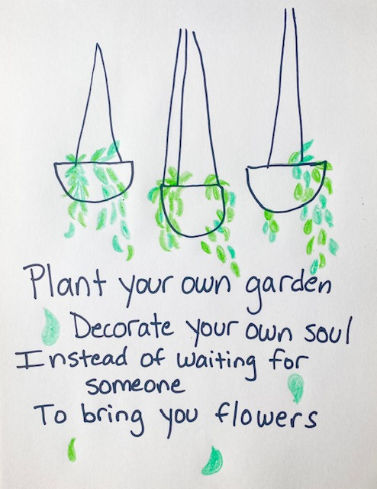

Slide 3
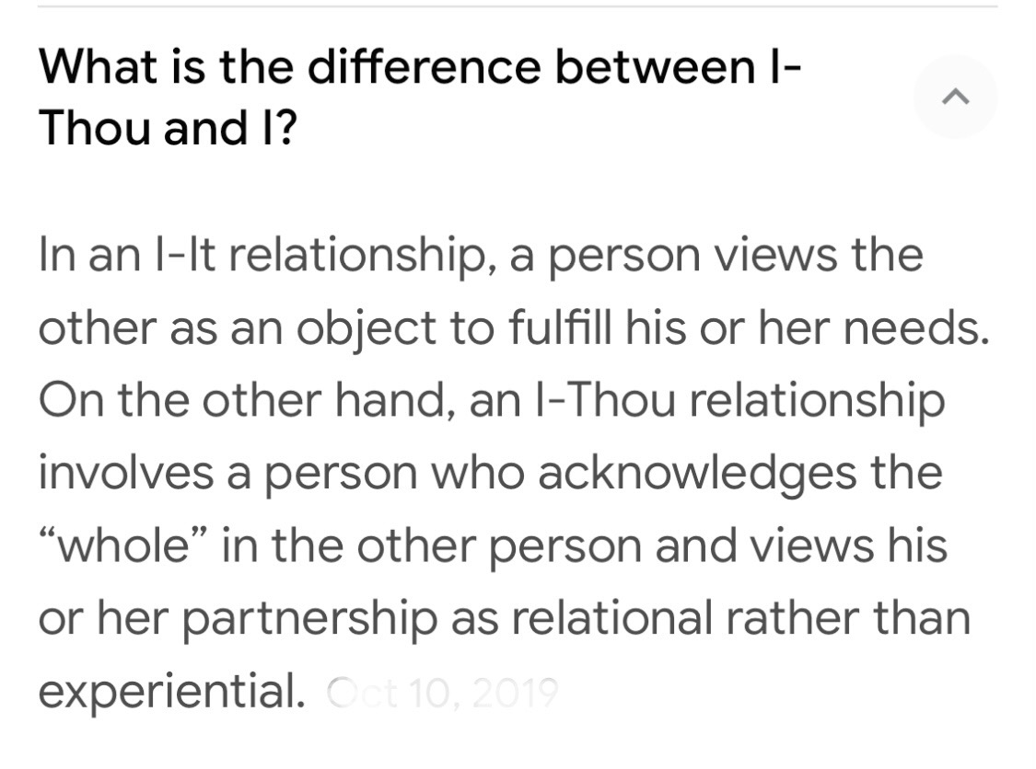

Slide 4
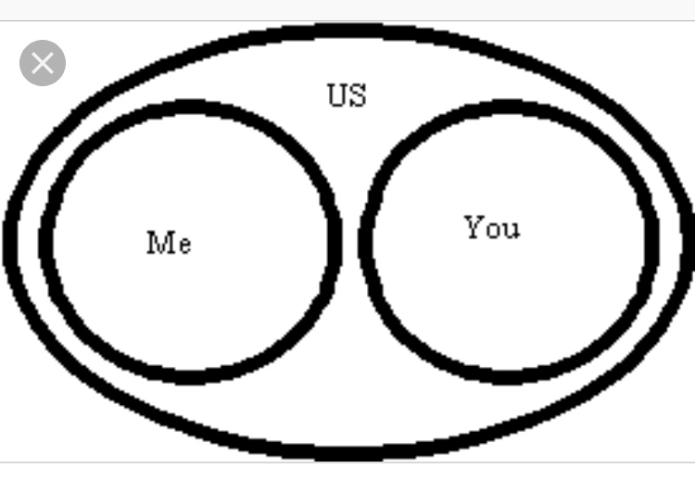
Intimacy

Slide 5
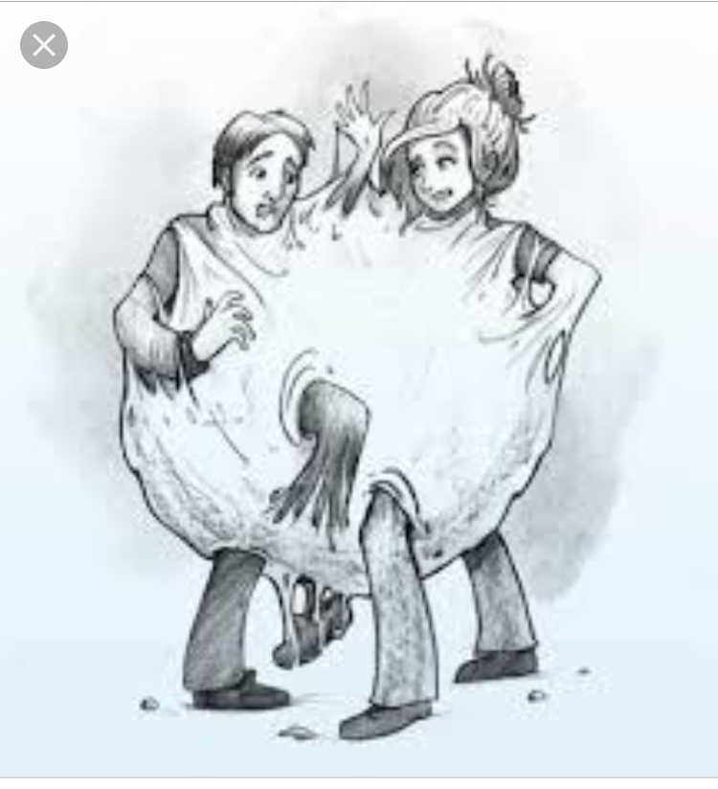
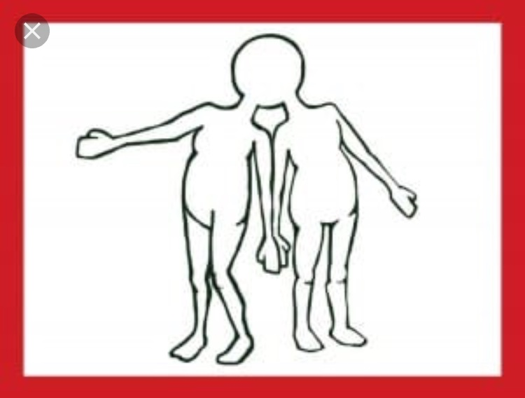
Enmeshment

Slide 7
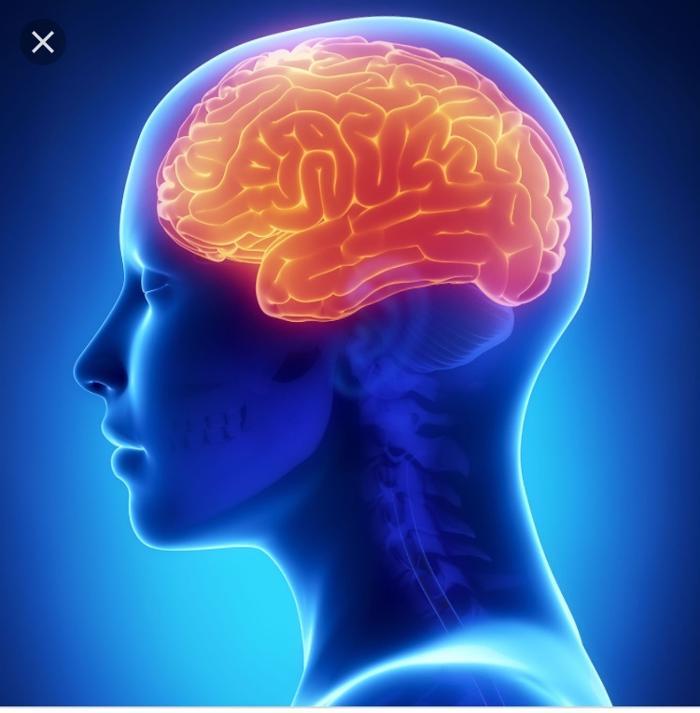
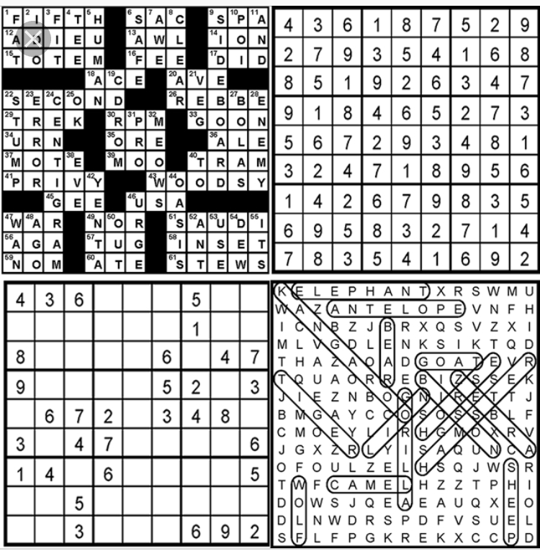
Intellectual Pursuits

Slide 8
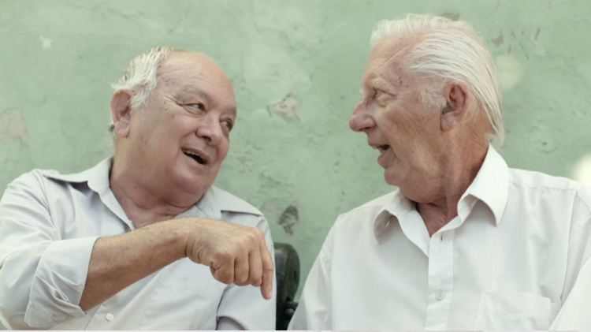
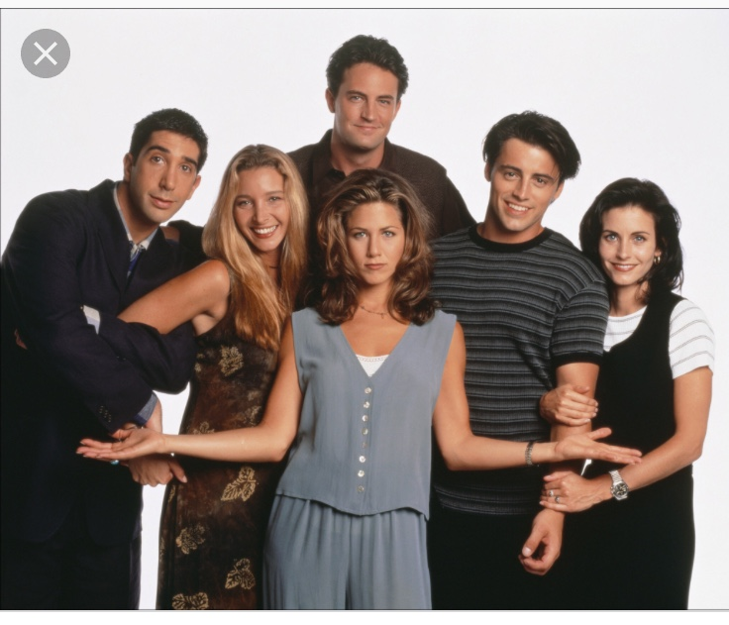
Friends & Community

Slide 9
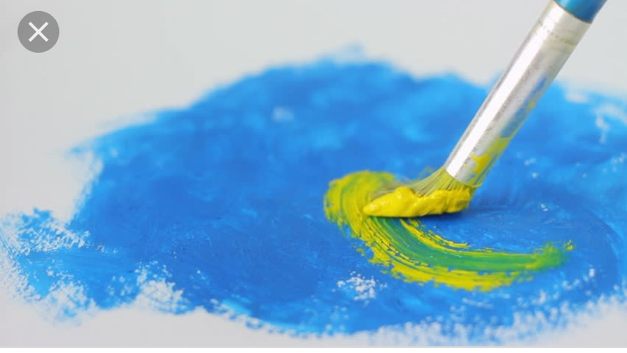
Creative Pursuits

Slide 10
Health & Exercise

Slide 11
Spirituality

Slide 12
Life Force & Sexuality

Slide 14
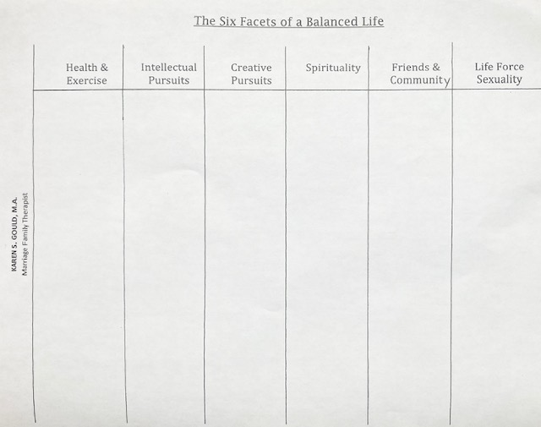

Slide 15
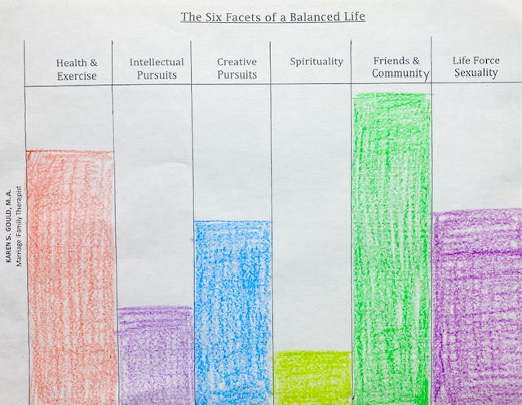

Slide 16
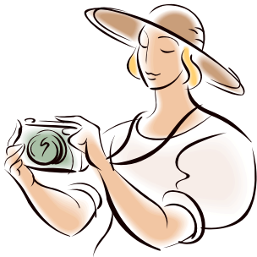
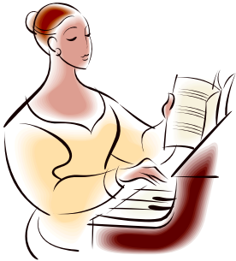
Yes, you ARE creative!!
Leave your inhibitions and self-critical voice at home, and immerse yourself in art, music, writing and improv
in a SAFE, SUPPORTIVE space
Nov 3, 10:00 - noon
Woodside Village Church
Guild Hall
Snacks and Drinks and supplies included
$150
Led by Karen S. Gould, LMFT
Art Psychotherapist
Sign up by emailing:
KarenGouldMFT@gmail.com
KarenGouldMFT.com

